Slide 1
Security

Slide 2
Introduction
Network security is a set of practices and technologies that protect computer networks and data from unauthorized access, misuse, or damage by implementing policies and controls for hardware, software, and user activity.
Its goal is to maintain the confidentiality, integrity, and availability (the "CIA triad") of the network and its resources by preventing, detecting, and monitoring threats like malware, hacking, and denial-of-service attacks.

Slide 3
Cont..
Key Aspects of Network Security
Hardware and Software: Involves a combination of both physical and digital tools, such as firewalls, intrusion detection systems, antivirus software, and access control tools.
Policies and Practices: Establishes rules for network access, user behavior, and data handling to create a secure environment.
Threat Protection: Aims to block various cyber threats, including malware (like ransomware), phishing attempts, and denial-of-service (DDoS) attacks that can disrupt services.
Data Protection: Focuses on safeguarding sensitive information from being stolen, altered, or made unavailable to authorized users.

Slide 4
Cont..
Network security is built around the principles of the CIA triad:
Confidentiality: Ensures that sensitive information is accessible only to authorized users.
Integrity: Guarantees that data is accurate, complete, and hasn't been tampered with during transmission or storage.
Availability: Ensures that network services and resources are accessible and available to authorized users when they need them.

Slide 5
Cont..
Why Network Security is Important
Protecting Sensitive Data: Prevents the theft of personal, financial, and intellectual property.
Ensuring Business Continuity: Safeguards against disruptions and downtime caused by cyberattacks, allowing businesses to operate uninterrupted.
Maintaining Reputation: Builds trust with customers and partners by demonstrating a commitment to protecting their data.
Meeting Compliance: Helps organizations comply with regulations that mandate the protection of data, avoiding legal and financial penalties.

Slide 6
How Does Network Security Work?
Network security uses multiple layers of protection, both at the network edge and within the internal environment.
Each layer enforces specific rules and controls to regulate access to network resources.
Authorized users can safely utilize the network, while malicious actors and threats are blocked from causing harm.
The basic principle of network security is protecting huge stored data and networks in layers that ensure the enforcement of rules and regulations that have to be acknowledged before performing any activity on the data.
These levels are:

Slide 7
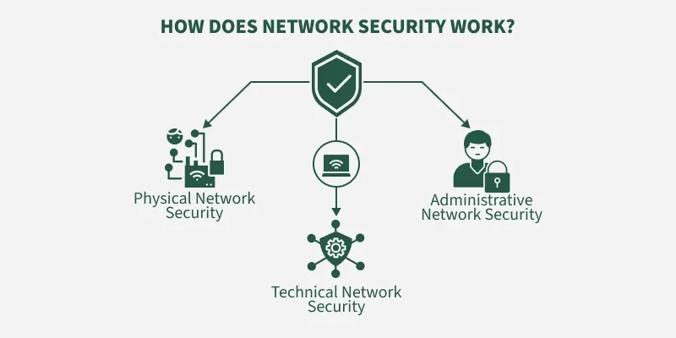

Slide 8
Cont..
Physical Network Security:
It is the foundational level of network protection, focused on preventing unauthorized individuals from gaining physical access to networking equipment and compromising the confidentiality of the network.
This can be achieved through measures such as biometric systems, access cards, and other physical security devices.
Technical Network Security:
It primarily focuses on protecting the data stored in the network or data involved in transitions through the network.
This type serves two purposes.
One is protected from unauthorized users, and the other is protected from malicious activities.

Slide 9
Cont..
Administrative Network Security:
This level of network security protects user behavior like how the permission has been granted and how the authorization process takes place.
This also ensures the level of sophistication the network might need for protecting it through all the attacks.
This level also suggests necessary amendments that have to be done to the infrastructure.

Slide 10
Need of Network Security
Network security is essential to protect an organization's digital assets, such as sensitive data and operations, from cyber threats like data breaches and unauthorized access.
Its importance stems from the need to ensure data confidentiality and integrity, maintain business continuity by preventing operational downtime, and comply with regulatory requirements.
Strong network security also builds customer trust, enhances brand reputation, and safeguards a company's intellectual property, ultimately protecting its overall financial health and operational efficiency.

Slide 11
Key Reasons for Network Security
Protecting Sensitive Data: To prevent unauthorized access to confidential information, including personal data, customer details, financial records, and intellectual property.
Ensuring Data Integrity: To maintain the reliability of network operations and ensure data is not modified, stolen, or damaged.
Maintaining Business Continuity: To prevent operational disruptions and downtime caused by cyberattacks, ensuring that critical business operations can continue smoothly.
Compliance with Regulations: To adhere to industry-specific and governmental regulations, such as GDPR and HIPAA, avoiding legal and financial penalties for data breaches.

Slide 12
Cont..
Preventing Cyber Threats: To mitigate risks from various threats, including malware, ransomware, and unauthorized probing, by implementing proactive security measures.
Building Customer Trust and Brand Reputation: To demonstrate a commitment to protecting client data, which enhances customer loyalty and strengthens the organization's reputation.
Protecting Intellectual Property: To safeguard a company's unique intellectual assets, such as trade secrets and business strategies, from theft and misuse.
Controlling Network Performance: To ensure high network functionality and performance by preventing intrusions and maintaining system efficiency.

Slide 13
Benefits of Effective Network Security
Reduced Financial Losses: Minimizes financial losses resulting from security breaches, data theft, and operational downtime.
Enhanced Operational Efficiency: Fewer interruptions and intrusions lead to improved network efficiency and increased business productivity.
Stronger Competitive Advantage: A robust security posture can attract and retain top talent, especially for roles handling sensitive information.
Attracting and Retaining Talent: Demonstrating strong security practices can influence potential and current employees to choose one employer over another.

Slide 14
Types of Network Security
Email Security
Network Segmentation
Access Control
Sandboxing
Cloud Network Security
Web Security
Intrusion Prevention System (IPS)
Antivirus and Anti-Malware Software
Firewall Security
Application Security
Wireless Security
Mobile Device Security
Industrial Network Security
VPN Security

Slide 15
Email Security
Email security refers to the processes and technologies designed to protect email accounts and their contents from unauthorized access, loss, or compromise.
For example, fraudulent or suspicious emails are often filtered into the spam folder, as most email service providers include built-in protection features.
One of the most common attack vectors for security breaches is the email gateway.
Cybercriminals frequently launch phishing campaigns that leverage personal information and social engineering techniques to deceive recipients and redirect them to malicious websites.
To prevent data loss and protect sensitive information, email security solutions block incoming threats and restrict unauthorized or risky outgoing messages.

Slide 16
Network Segmentation
Network Segmentation involves dividing network traffic into different categories through software-defined mechanisms, which also support the enforcement of security policies.
Instead of relying solely on IP addresses, classifications are ideally based on endpoint identity.
Access permissions can then be assigned according to role, location, or other factors, ensuring that individuals receive the appropriate level of access while suspicious devices are isolated and remediated

Slide 17
Access Control
Your network should not be openly accessible to all users.
To prevent unauthorized access, it is essential to identify every user and device attempting to connect.
Once identified, security policies can be enforced to ensure compliance.
Noncompliant endpoint devices may have their access restricted or blocked entirely.
This process is known as Network Access Control (NAC).

Slide 18
Sandboxing
Sandboxing is a cybersecurity technique in which files are opened or code is executed within a secure, isolated environment that simulates an end-user operating system.
This approach prevents potential threats from reaching the network by monitoring the behavior of code or files as they run and detecting any malicious activity.

Slide 19
Cloud Network Security
Cloud environments are highly vulnerable to misuse by unauthorized parties, making it essential to protect stored data and ensure that such protection is never compromised.
Many organizations adopt Software-as-a-Service (SaaS) applications, which allow certain employees to access cloud-stored data.
However, this often creates gaps in data visibility and control.
Workloads and applications are no longer confined to on-site data centers; instead, they are increasingly deployed in the cloud.
As a result, protecting the modern data center requires greater adaptability and innovation to secure dynamic, cloud-based application workloads

Slide 20
Web Security
Web security solutions manage employee internet usage, block access to malicious websites, and prevent web-based threats.
They protect web gateways both on-site and in the cloud.
In addition, web security also involves safeguarding personal or organizational websites from attacks and vulnerabilities.

Slide 21
Intrusion Prevention System
An Intrusion Prevention System (IPS), also known as an Intrusion Detection and Prevention System (IDPS), is a network security tool that monitors network or system activity for malicious behavior.
Its key functions include detecting malicious activity, collecting information, generating reports, and blocking or mitigating threats in real time.

Slide 22
Antivirus and Anti-Malware Software
Antivirus and anti-malware solutions prevent malicious software such as viruses, Trojans, and worms from entering a network.
These tools not only stop malware from infiltrating but also provide defense mechanisms to detect, remove, and remediate infections if they occur.

Slide 23
Firewall Security
Firewalls act as a barrier between trusted and untrusted networks by monitoring and filtering incoming and outgoing traffic based on predefined rules.
They play a critical role in preventing unauthorized access while permitting legitimate communication.

Slide 24
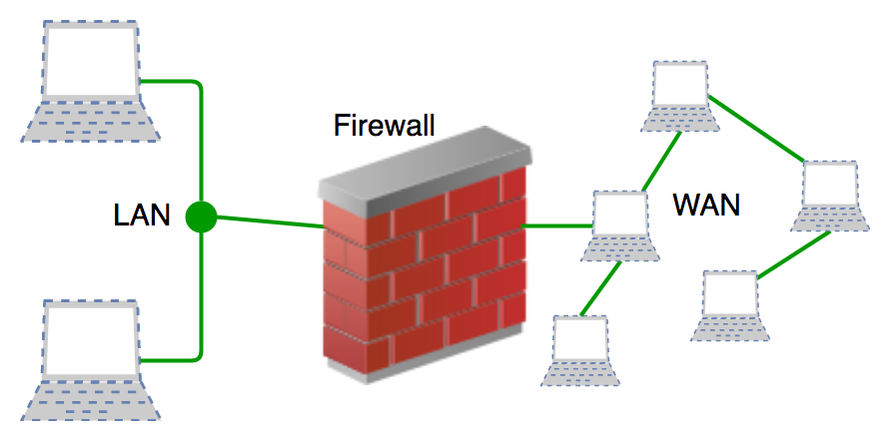

Slide 25
Application Security
Application security refers to measures taken at the application level to protect sensitive data and code from theft or manipulation.
This includes security practices applied during the design, development, and deployment of applications, as well as ongoing techniques to secure applications against evolving threats.

Slide 26
Wireless Security
Wireless networks are inherently less secure than wired ones. Without proper safeguards, a wireless LAN can act like open Ethernet ports accessible from anywhere including outside the building.
Wireless security solutions are specifically designed to prevent unauthorized access and protect against exploits targeting wireless communication.

Slide 27
Mobile Device Security
With the rise of Bring Your Own Device (BYOD) practices, cybercriminals increasingly target mobile devices and applications.
To mitigate risks, organizations must regulate which devices can connect to the network, enforce secure connection protocols, and monitor mobile traffic to protect against unauthorized access.

Slide 28
Industrial Network Security
As industries adopt digital transformation and integrate IT with Operational Technology (OT), Industrial Control Systems (ICS) face growing cyber threats.
Industrial network security involves segmenting OT networks, maintaining visibility into device behavior, and integrating OT insights into IT security tools.
This helps monitor, detect, and mitigate threats to critical industrial infrastructure.

Slide 29
VPN Security
A Virtual Private Network (VPN) secures communication between devices and networks, often over the internet, by encrypting the connection.
Remote-access VPNs typically use IPsec or Secure Sockets Layer (SSL) protocols to authenticate and protect data, ensuring confidentiality and privacy against unauthorized access.

Slide 30
VPN-Virtual Private Netwrok
A Virtual Private Network (VPN) creates an encrypted, private connection over a public network like the internet, allowing you to browse the web more securely and anonymously.
It works by routing your internet traffic through a remote VPN server, masking your real IP address and encrypting your data, which protects it from being intercepted or tracked by third parties.

Slide 31
How a VPN works:
Encrypted Tunnel: When you activate a VPN, it establishes a secure, encrypted "tunnel" between your device and the VPN server.
IP Address Masking: Your internet traffic is directed through this tunnel to the VPN server, and then to its final destination on the internet. This makes it appear as if your data is coming from the VPN server's location, not your own, effectively masking your true IP address.
Data Encryption: All the data sent and received through this tunnel is encrypted, converting it into unreadable code that is useless to anyone who intercepts it without the correct decryption key.

Slide 32
Why use a VPN?
Enhanced Security: VPNs encrypt your data, making it much harder for hackers and snoopers to steal sensitive information like passwords and credit card details, especially on public Wi-Fi networks.
Privacy and Anonymity: By hiding your IP address and encrypting your traffic, a VPN prevents your Internet Service Provider (ISP) and other third parties from seeing your browsing activity, identity, and online location.
Circumventing Geo-Restrictions and Censorship: VPNs allow you to bypass internet blocks and access content that might be restricted in your physical location by making it appear you are browsing from a different country.
Remote Work: Businesses use VPNs to provide employees with secure access to internal company networks and resources from remote locations, protecting sensitive corporate data.

Slide 33
Types of Attacks
Network attacks involve unauthorized access, disruption, and malicious data manipulation, with common types including Malware (viruses, ransomware), Phishing (deceptive emails), Denial-of-Service (DoS) and DDoS attacks (overwhelming systems), Man-in-the-Middle (MitM) attacks (intercepting communications), Social Engineering (manipulating people), and Code Injection attacks (exploiting vulnerabilities, like SQL injection).

Slide 34
Cont..
Malware Attacks:
Malicious software such as viruses, worms, ransomware, and spyware are used to gain unauthorized access, damage systems, or steal data.
Virus -
A malware which requires some form of user's interaction to infect the user's device.
The classic example is an e-mail attachment containing malicious executable code.
If a user receives and opens such an attachment, the user inadvertently runs the malware on the device.

Slide 35
Cont..
Worm -
A malware which can enter a device without any explicit user interaction.
For example, a user may be running a vulnerable network application to which an attacker can send malware.
In some cases, without any user intervention, the application may accept the malware from the Internet and run it, creating a worm.
Botnet -
A network of private computers infected with malicious software and controlled as a group without the owners' knowledge, e.g. to send spam.

Slide 36
Cont..
Phishing Attacks: Attackers send deceptive emails or messages to trick users into revealing sensitive information, like passwords or financial data.
Denial-of-Service (DoS) and Distributed Denial-of-Service (DDoS) Attacks: DoS attacks overwhelm a network, server, or website with traffic, making it unavailable to its intended users. A DDoS attack uses multiple compromised systems to amplify this effect.
Man-in-the-Middle (MitM) Attacks: Attackers position themselves between two communicating parties to intercept, view, or alter their communications.

Slide 37
Cont..
Social Engineering Attacks: These attacks manipulate people into divulging information or performing actions that compromise security, often by exploiting human psychology.
Unauthorized Access Attacks: These attacks aim to gain entry into network systems or accounts without permission, using methods like brute-force attacks or credential stuffing.
Code Injection Attacks: Also known as SQL injection attacks, these are used to exploit vulnerabilities in web applications, allowing attackers to execute malicious code or gain control of databases.

Slide 38
Cont..
Ransomware Attacks: A type of malware that encrypts a victim's files, demanding a ransom payment for their decryption.
Insider Threats: Malicious actions taken by a legitimate user within an organization, or an unintentional security lapse by an authorized individual.
Supply Chain Attacks: Attackers compromise a trusted third-party software vendor or service provider to gain access to the networks of their clients, according to Meter.

Slide 39
ITU-T X.800 Security Architecture for OSI
Security Architecture defines a systematic approach to providing security at each layer.
It defines security services and security mechanisms that can be used at each of the seven layers of the OSI model to provide security for data transmitted over a network.
These security services and mechanisms help to ensure the confidentiality, integrity, and availability of the data.
OSI architecture is internationally acceptable as it lays the flow of providing safety in an organization.
OSI Security Architecture focuses on these concepts:
Security Attack
Security mechanism
Security Service

Slide 40
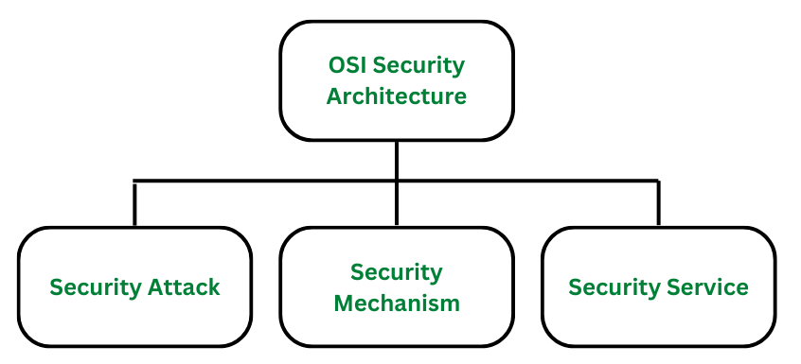

Slide 41
Cont..
1. Security Attacks
A security attack is an attempt by a person or entity to gain unauthorized access to disrupt or compromise the security of a system, network, or device.
These are defined as the actions that put at risk an organization's safety.
They are further classified into 2 sub-categories:
Passive Attacks
Active Attacks

Slide 42
Cont..
Passive Attack:
Attacks in which a third-party intruder tries to access the message/ content/ data being shared by the sender and receiver by keeping a close watch on the transmission or eave-dropping the transmission is called Passive Attacks.
These types of attacks involve the attacker observing or monitoring system, network, or device activity without actively disrupting or altering it.
Passive attacks are typically focused on gathering information or intelligence, rather than causing damage or disruption.
Here, both the sender and receiver have no clue that their message/ data is accessible to some third-party intruder.
The message/ data transmitted remains in its usual form without any deviation from its usual behavior.
This makes passive attacks very risky as there is no information provided about the attack happening in the communication process.

Slide 43
Cont..
Passive attacks are further divided into two parts based on their behavior:
Eavesdropping: Eavesdropping involves the attacker intercepting and listening to communications between two or more parties without their knowledge or consent. Eavesdropping can be performed using a variety of techniques, such as packet sniffing, or man-in-the-middle attacks.
Traffic analysis: This involves the attacker analyzing network traffic patterns and metadata to gather information about the system, network, or device. Here the intruder can't read the message but only understand the pattern and length of encryption. Traffic analysis can be performed using a variety of techniques, such as network flow analysis, or protocol analysis.

Slide 44
Cont..
Active Attacks:
Active attacks refer to types of attacks that involve the attacker actively disrupting or altering system, network or device activity.
Active attacks are typically focused on causing damage or disruption rather than gathering information or intelligence.
Here, both the sender and receiver have no clue that their message/ data is modified by some third-party intruder.
The message/ data transmitted doesn't remain in its usual form and shows deviation from its usual behavior.
This makes active attacks dangerous as there is no information provided of the attack happening in the communication process and the receiver is not aware that the data/ message received is not from the sender.

Slide 45
Cont..
Active attacks are further divided into four parts based on their behavior:
Masquerade: Masquerade is a type of attack in which the attacker pretends to be an authentic sender in order to gain unauthorized access to a system. This type of attack can involve the attacker using stolen or forged credentials, or manipulating authentication or authorization controls in some other way.
Replay: Replay is a type of active attack in which the attacker intercepts a transmitted message through a passive channel and then maliciously or fraudulently replays or delays it at a later time.
Modification of Message: Modification of Message involves the attacker modifying the transmitted message and making the final message received by the receiver look like it's not safe or non-meaningful. This type of attack can be used to manipulate the content of the message or to disrupt the communication process.
Denial of service (DoS): Denial of Service attacks involve the attacker sending a large volume of traffic to a system, network, or device in an attempt to overwhelm it and make it unavailable to users.

Slide 46
Cont..
2. Security Mechanism
The mechanism that is built to identify any breach of security or attack on the organization, is called a security mechanism. Security Mechanisms are also responsible for protecting a system, network, or device against unauthorized access, tampering, or other security threats.
Encipherment (Encryption): Encryption involves the use of algorithms to transform data into a form that can only be read by someone with the appropriate decryption key. Encryption can be used to protect data it is transmitted over a network, or to protect data when it is stored on a device.
Digital signature: Digital Signature is a security mechanism that involves the use of cryptographic techniques to create a unique, verifiable identifier for a digital document or message, which can be used to ensure the authenticity and integrity of the document or message.

Slide 47
Cont..
Traffic padding: Traffic Padding is a technique used to add extra data to a network traffic stream in an attempt to obscure the true content of the traffic and make it more difficult to analyze.
Routing control: Routing Control allows the selection of specific physically secure routes for specific data transmission and enables routing changes particularly when a gap in security is suspected.

Slide 48
Cont..
3. Security Services
Security services refer to the different services available for maintaining the security and safety of an organization. They help in preventing any potential risks to security. Security services are divided into 5 types:
Authentication: Authentication is the process of verifying the identity of a user or device in order to grant or deny access to a system or device.
Access control: Access Control involves the use of policies and procedures to determine who is allowed to access specific resources within a system.
Data Confidentiality: Data Confidentiality is responsible for the protection of information from being accessed or disclosed to unauthorized parties.
Data integrity: Data Integrity is a security mechanism that involves the use of techniques to ensure that data has not been tampered with or altered in any way during transmission or storage.
Non- repudiation: Non-repudiation involves the use of techniques to create a verifiable record of the origin and transmission of a message which can be used to prevent the sender from denying that they sent the message.

Slide 49
Benefits of OSI Security Architecture
Providing Security: OSI Architecture in an organization provides the needed security and safety preventing potential threats and risks.
Organising Task: The OSI architecture makes it easy for managers to build a security model for the organization based on strong security principles.
Meets International Standards: Security services are defined and recognized internationally meeting international standards.
Interoperability: The OSI model divides network functions into multiple levels makes it easier for different hardware and software components to work together.
Scalability: The layered method makes networks scalable. New technologies and protocols can be seamlessly added without interrupting the overall system.
Flexibility: Each layer can evolve separately and provide flexibility for technology and application changes.

Slide 50
Security Policy and mechanisms
Security policies are statements of rules defining what is and isn't allowed to protect an organization's assets, while security mechanisms are the methods, tools, or procedures used to enforce these policies and protect against threats.
Policies set the security strategy and goals (like confidentiality, integrity, and availability), while mechanisms implement these goals through actions like encryption, access controls, firewalls, and authentication.

Slide 51
Security Policies
Definition:
A security policy is a comprehensive document outlining the rules, guidelines, and intentions for how an organization will protect its information systems and data.
Purpose:
To establish a clear, consistent framework for security, ensure awareness of security responsibilities, meet compliance requirements, and guide the implementation of security controls.
Types:
Organizational: A master blueprint for the entire organization's security program.
System-specific: Covers security for a particular network or information system.
Issue-specific: Targets specific aspects, such as acceptable use, access control, incident response, or password management.
Examples:
Acceptable use policies, access control policies, password policies, incident response policies, and remote access policies.

Slide 52
Cont..
Security Mechanisms
Definition:
A security mechanism is a method, tool, or process used to implement the rules set by a security policy.
Purpose:
To enforce policy, protect data and systems from unauthorized access and attacks, and maintain confidentiality, integrity, and availability.
Types:
Specific Mechanisms: Integrated into a specific protocol layer to provide particular security services.
Pervasive Mechanisms: Generalized controls not tied to a single layer or service.
Examples:
Encryption: Hides data by converting it into an unreadable format.
Firewalls: Control network traffic to prevent unauthorized access.
Access Control: Defines and enforces who can access specific resources.
Authentication: Verifies a user's identity before granting access.
Digital Signatures: Use cryptographic techniques to ensure document authenticity and integrity.

Slide 53
Cryptography
Cryptography is the science of secure communication and information protection, using mathematical algorithms to encode messages to prevent unauthorized access by third parties.
It relies on concepts like encryption, where data is scrambled into an unreadable format (ciphertext), and decryption, where it is restored to its original, readable form (plaintext) using a key.
Modern cryptography ensures data confidentiality, integrity, and authenticity, playing a crucial role in digital security for everything from online banking to military communications.

Slide 54
How it Works
Encryption: A mathematical process that converts readable data into an unreadable format (ciphertext).
Decryption: The reverse process, using a secret key to convert the ciphertext back into the original, understandable plaintext.
Algorithms: Sets of rules and mathematical formulas used for encryption and decryption.
Keys: Secret pieces of information, like a password, that are required to decrypt the encrypted message.
Cryptanalysis: The practice of breaking encrypted messages to discover their original meaning without the key.

Slide 55
Key Principles
Cryptography ensures several vital aspects of information security:
Confidentiality: Ensures that information is accessible only to authorized individuals.
Integrity: Guarantees that data has not been altered or tampered with.
Authentication: Verifies the identity of the sender and recipient.
Non-repudiation: Prevents the sender from denying their involvement in creating or sending information.

Slide 56
Common Applications
Cryptography is a fundamental part of modern cybersecurity and is used in:
Online Transactions: Securing e-commerce and banking operations with protocols like TLS.
Digital Security: Protecting computer passwords, emails, and sensitive data.
Digital Currencies: Powering blockchain systems for cryptocurrencies and smart contracts.
Secure Communication: Used in military and private communications to protect sensitive information.

Slide 57
Authentication and Authorization
Authentication is the process of verifying a user's identity to confirm they are who they claim to be, using methods like passwords, biometrics, or tokens.
Authorization is the process that determines what an authenticated user is permitted to access or do within a system, like accessing specific files or performing certain actions.
In essence, authentication answers "Who are you?" and authorization answers "What are you allowed to do?".

Slide 58
Cont..
Authentication
Purpose: To verify a user's identity.
How it works: By providing credentials such as a password, fingerprint, or a one-time code.
Example: When you log in to an email service and enter your username and password, the service authenticates you.
Authorization
Purpose: To grant or deny permissions to specific resources.
How it works: Based on defined access control policies, roles, or rules.
Example: After you're authenticated, authorization ensures you can only access your own mailbox, not someone else's, in the email service.

Slide 59
Relationship between Authentication and Authorization
A prerequisite: You must first be authenticated before authorization can take place.
Combined security: Both processes are vital for securing systems, applications, and data.
Example: At a hotel, your ID authenticates your identity (proves you are who you say you are), and a key authorizes your access to your room (grants permission to enter).

Slide 60
Symmetric and Asymmetric Key Encryption
Encryption is one of the most basic concepts in the world of cybersecurity as it ensures that some information does not fall into the wrong hands.
There are two primary types of encryption techniques namely, symmetric key encryption and asymmetric key encryption.
Anyone involved in data security must know the differences between these two methods.

Slide 61
What is Symmetric Key Encryption?
In Symmetric-key encryption the message is encrypted by using a key and the same key is used to decrypt the message which makes it easy to use but less secure.
It also requires a safe method to transfer the key from one party to another.
It uses one key for both encryption and decryption.
Faster and more efficient for large amounts of data.
Requires a secure method to share the key between sender and receiver.
Common algorithms include AES, DES, Blowfish.
It is used in file encryption, VPNs, and secure data storage.

Slide 62
What is Asymmetric Key Encryption?
Asymmetric key encryption is one of the most common cryptographic methods that involve using a single key and its pendent, where one key is used to encrypt data and the second one is used to decrypt an encrypted text.
The second key is kept highly secret, while the first one which is called a public key can be freely distributed among the service’s users.
It uses two keys a public key for encryption and a private key for decryption.
More secure but slower than symmetric encryption.
No need to share the private key, reducing the risk of exposure.
Common algorithms include RSA, ECC, Diffie-Hellman.
It is used in digital signatures, SSL/TLS, and secure email communication.

Slide 63
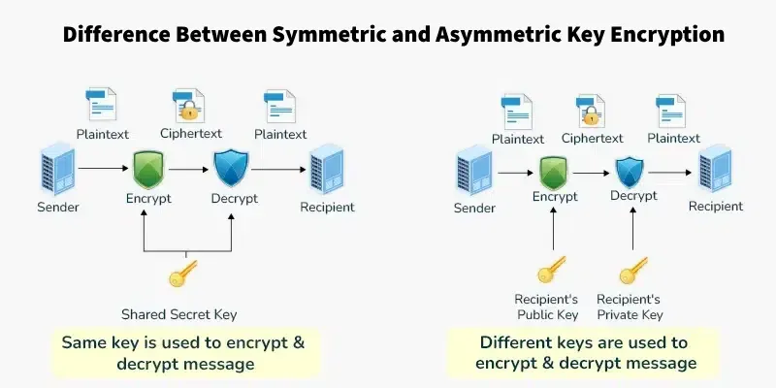

Slide 64
Symmetric Key Encryption | Asymmetric Key Encryption
It only requires a single key for both encryption and decryption. | It requires two keys, a public key and a private key, one to encrypt and the other to decrypt.
The size of ciphertext is the same or smaller than the original plaintext. | The size of ciphertext is the same or larger than the original plaintext.
The encryption process is very fast. | The encryption process is slow.
It is used when a large amount of data needs to be transferred. | It is used to transfer small amount of data.
It only provides confidentiality. | It provides confidentiality, authenticity, and non-repudiation.

Slide 65
The length of key used is 128 or 256 bits | The length of key used is 2048 or higher
In symmetric key encryption, resource utilization is low compared to asymmetric key encryption. | In asymmetric key encryption, resource utilization is high.
It is efficient as it is used for handling large amount of data. | It is comparatively less efficient as it can handle a small amount of data.
Security is lower as only one key is used for both encryption and decryption purposes. | Security is higher as two keys are used, one for encryption and the other for decryption.
The Mathematical Representation is as follows- P = D (K, E(K, P)) where K --> encryption and decryption key P --> plain text D --> Decryption E(K, P) --> Encryption of plain text using K | The Mathematical Representation is as follows- P = D(Kd, E (Ke,P)) where Ke --> encryption key Kd --> decryption key D --> Decryption E(Ke, P) --> Encryption of plain text using encryption key Ke. P --> plain text
Examples: 3DES, AES, DES and RC4 | Examples: Diffie-Hellman, ECC, El Gamal, DSA and RSA

Slide 66
Security in Network, Transport and Application:

Slide 67
Introduction of IPSec
IPsec, or Internet Protocol Security, is a standardized suite of protocols that secures IP communications by encrypting and authenticating each IP packet of a data stream.
It provides confidentiality, integrity, and authentication for data transmitted over a network, often used to establish secure VPN connections between two points, such as a user's device and a corporate network.
The framework involves two primary phases, starting with Internet Key Exchange (IKE) for establishing security associations and exchanging keys, followed by encrypting and authenticating the actual data packets using protocols like Authentication Header (AH) and Encapsulating Security Payload (ESP).

Slide 68
How IPsec Works
Authentication and Key Exchange (IKE):
This is the first phase where two devices (peers) use the Internet Key Exchange (IKE) protocol to authenticate each other.
They establish a secure channel and agree on the cryptographic keys that will be used for the actual data.
Data Encryption and Integrity:
In the second phase, IPsec protocols like AH and ESP are used to encrypt the data and ensure its integrity.
ESP (Encapsulating Security Payload): Encrypts and authenticates the IP packet's data.
AH (Authentication Header): Provides authentication and integrity for the entire IP packet.

Slide 69
Cont..
Modes of Operation: IPsec can operate in two modes:
Tunnel Mode: Encapsulates the entire original IP packet within a new IP packet, providing comprehensive security.
Transport Mode: Secures only the data payload of the IP packet, leaving the original IP header unchanged.

Slide 70
Key Features
Confidentiality: Prevents unauthorized parties from reading data.
Integrity: Ensures that data has not been modified during transit.
Authentication: Verifies the identity of the communicating devices.
Network Layer Security: Operates at the network layer (Layer 3) of the OSI model, providing security for IP-based communication.

Slide 71
Common Use Cases
IPsec VPNs: The most common use is to create a Virtual Private Network, allowing secure connections between users and networks or between two networks over the internet.
Secure Data Transfer: Secures data for applications that require robust end-to-end encryption and authentication.

Slide 72
SSL-
SSL (Secure Sockets Layer) is an older internet security protocol, now largely replaced by TLS (Transport Layer Security), that encrypts data transmitted between a client and a server for privacy and security.
Websites using SSL/TLS show "HTTPS" in their URL, and the system involves an SSL certificate to authenticate the server and a handshake to establish a secure, encrypted connection, ensuring data integrity and preventing unauthorized access.

Slide 73
What SSL/TLS does:
Encryption: It scrambles data sent over the internet, making it unreadable to anyone who might intercept it.
Authentication: It verifies the identity of the server (the website or application) to ensure that the user is communicating with the legitimate entity and not a malicious imposter.
Data Integrity: It ensures that the data hasn't been tampered with or altered during transmission.

Slide 74
Cont..
How it works (simplified):
Handshake: When you visit a secure website (HTTPS), your browser initiates a handshake with the server.
Certificate Exchange: The server presents its SSL certificate, which acts as a digital identity card verified by a trusted third party called a Certificate Authority (CA).
Key Exchange: The browser and server use public and private keys to establish a secure, encrypted communication channel.
Encrypted Connection: All future data transmitted between the browser and the server is encrypted.

Slide 75
Why it's important:
Security: It protects sensitive information like usernames, passwords, and credit card details from being stolen by hackers.
Trust: An HTTPS connection helps users trust a website or application, especially for online transactions.
SEO: Search engines like Google favor secure websites, rewarding them with higher search rankings.

Slide 76
HTTPS
HTTPS, or HyperText Transfer Protocol Secure, is the secure, encrypted version of the standard HTTP protocol for web communication, using SSL/TLS to encrypt data between a user's browser and a website, protecting sensitive information like passwords and credit card details from interception.
You can identify an HTTPS connection by a padlock icon in the address bar and the "https://" prefix in the URL, which indicates the website is secure and uses an SSL/TLS certificate to verify its identity.
HTTPS is the secure variant of HTTP and is used to communicate between the user's browser and the website, ensuring that data transfer is encrypted for added security.
Any website, especially those requiring login details, should use HTTPS.

Slide 77
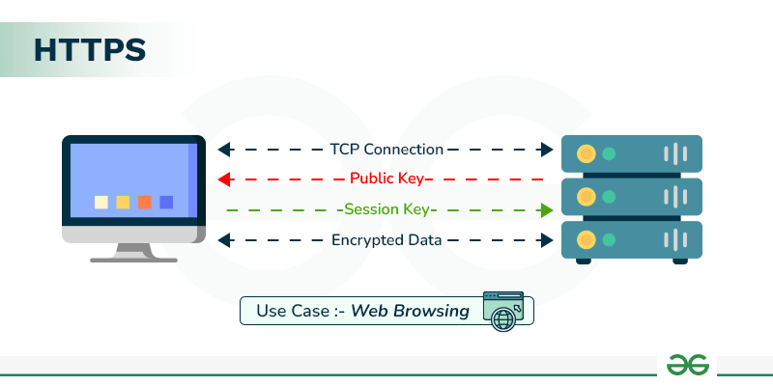

Slide 78
How Does HTTPS Work?
HTTPS establishes the communication between the browser and the web server. It uses the Secure Socket Layer (SSL) and Transport Layer Security (TLS) protocol for establishing communication.
The new version of SSL is TLS(Transport Layer Security).
HTTPS uses the conventional HTTP protocol and adds a layer of SSL/TLS over it.
The workflow of HTTP and HTTPS remains the same, the browsers and servers still communicate with each other using the HTTP protocol.
However, this is done over a secure SSL connection.
The SSL connection is responsible for the encryption and decryption of the data that is being exchanged to ensure data safety.

Slide 79
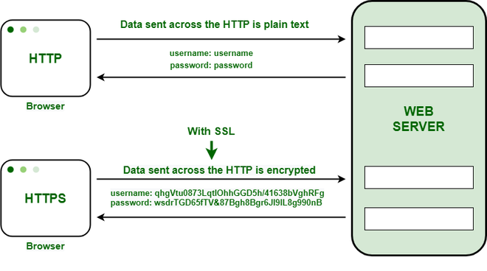

Slide 80
How does it works
Encryption: When you connect to an HTTPS website, your browser and the web server establish a secure, encrypted connection using the SSL/TLS protocol.
Data Exchange: All data exchanged between your browser and the website is encrypted, meaning it's transformed into an unreadable format.
Decryption: Only the client (your browser) and the server have the necessary keys to decrypt and read the data.
Verification: An SSL/TLS certificate on the website's server verifies its identity, ensuring you are connected to the legitimate website and not a fake one.

Slide 81
Why HTTPS is important
Security: It encrypts your data, preventing hackers from intercepting and stealing sensitive information like financial details or login credentials.
Trust and Confidence: The padlock icon and "https://" prefix provide visual assurance to users that a website is secure, building trust for online activities like banking and shopping.
Authentication: It authenticates the web server, confirming you are communicating with the real website and preventing spoofing attacks.
Protection from Content Manipulation: HTTPS prevents third parties, such as internet service providers, from injecting unauthorized content or malicious code into webpages you visit.
Search Engine Ranking: Search engines, including Google, prioritize secure websites using HTTPS as a ranking signal, boosting their visibility in search results.

Slide 82
Basic difference between HTTP and HTTPS
HTTP | HTTPS
HTTP stands for HyperText Transfer Protocol. | HTTPS stands for HyperText Transfer Protocol Secure.
URL begins with “http://”. | URL starts with “https://”.
HTTP Works at the Application Layer. | HTTPS works at Transport Layer.
HTTP speed is faster than HTTPS. | HTTPS speed is slower than HTTP.

Slide 83
S/MIME
S/MIME stands for Secure/Multipurpose Internet Mail Extensions. Through encryption, S/MIME offers protection for business emails. S/MIME comes under the concept of Cryptography.
S/MIME is a protocol used for encrypting or decrypting digitally signed E-mails.
This means that users can digitally sign their emails as the owner(sender) of the e-mail.

Slide 84
Cont..
S/MIME, or Secure/Multipurpose Internet Mail Extensions, is an industry-standard protocol for securing email through public-key encryption and digital signatures.
It provides email security by ensuring message integrity (the message wasn't altered), authenticity (it came from the claimed sender), confidentiality (only the intended recipient can read it), and non-repudiation.
S/MIME uses asymmetric encryption, involving a public key for encryption and a private key for decryption, and requires an S/MIME certificate to verify identity and enable secure communication.

Slide 85
How S/MIME Works
Encryption: The sender encrypts the email using the recipient's public key, which is mathematically linked to the recipient's private key.
Digital Signature: The sender also creates a digital signature using their own private key to authenticate their identity.
Decryption: The recipient receives the encrypted email and digital signature. They use their own private key to decrypt the message and their own public key to verify the sender's digital signature.

Slide 86
Key Benefits
Confidentiality: Prevents unauthorized access to the email's content by encrypting it.
Authenticity: Verifies the identity of the sender, ensuring they are who they claim to be.
Message Integrity: Guarantees that the message content has not been altered since it was sent.
Non-repudiation: Prevents the sender from denying they sent the message.

Slide 87
Who Uses S/MIME?
S/MIME is widely used by corporations and organizations to protect sensitive business communications, with support for the protocol available in enterprise email clients like Outlook for Microsoft 365 and Apple's Mail app.

Slide 88
Overview of IDS and Firewall
A firewall acts as a perimeter guard, controlling network traffic based on rules to prevent unauthorized access by blocking or permitting data.
In contrast, an Intrusion Detection System (IDS) is a monitoring tool that analyzes network traffic for suspicious patterns or known threats and alerts administrators when potential malicious activity is detected.
Firewalls block, while IDS detects and alerts; they are complementary, with the IDS often placed behind the firewall for deeper inspection of allowed traffic.

Slide 89
Firewall
Function:
To control and filter network traffic, acting as a barrier between networks with different security levels.
Method:
Uses pre-defined rules based on IP addresses, ports, and protocols to decide whether to permit or deny network connections.
Action:
Primarily a preventative measure, designed to stop unauthorized traffic from entering or leaving a network.
Placement:
Typically positioned at the network's perimeter as the first line of defense.

Slide 90
Intrusion Detection System (IDS)
Function:
To monitor network traffic for any signs of malicious activity or security breaches that might get past the firewall.
Method:
Analyzes traffic by comparing it against a database of known attack patterns (signatures) or by identifying deviations from normal network behavior (anomalies).
Action:
A detective and alerting tool, it generates alarms when a threat is identified. It doesn't typically block traffic itself, but its alerts prompt security personnel to take action.
Placement:
Strategically placed at key points within the network, often behind the firewall, to get a clear view of traffic that the firewall has already allowed through.

Slide 91
How They Work Together
A firewall filters traffic, allowing only approved connections to pass through.
The IDS then monitors this approved traffic for any signs of a compromise that the firewall might have missed.
This layered approach provides a more comprehensive security posture, with the firewall preventing broad access and the IDS providing a deeper, more detailed analysis of ongoing threats.

Slide 92
Key Distinction Summary
Firewall: Blocks or allows traffic based on explicit rules (control).
IDS: Detects suspicious activity and alerts (monitoring and detection).

Slide 93
IDS
Intrusion Detection System (IDS) observes network traffic for malicious transactions and sends immediate alerts when it is observed.
It is software that checks a network or system for malicious activities or policy violations.
Each illegal activity or violation is often recorded either centrally using an SIEM system or notified to an administration.
IDS monitors a network or system for malicious activity and protects a computer network from unauthorized access from users, including perhaps insiders.
The intrusion detector learning task is to build a predictive model (i.e. a classifier) capable of distinguishing between ‘bad connections’ (intrusion/attacks) and ‘good (normal) connections’.

Slide 94
Common Methods of Intrusion
Address Spoofing: Hiding the source of an attack by using fake or unsecured proxy servers making it hard to identify the attacker.
Fragmentation: Sending data in small pieces to slip past detection systems.
Pattern Evasion: Changing attack methods to avoid detection by IDS systems that look for specific patterns.
Coordinated Attack: Using multiple attackers or ports to scan a network, confusing the IDS and making it hard to see what is happening.

Slide 95
Working of Intrusion Detection System(IDS)
An IDS (Intrusion Detection System) monitors the traffic on a computer network to detect any suspicious activity.
It analyzes the data flowing through the network to look for patterns and signs of abnormal behavior.
The IDS compares the network activity to a set of predefined rules and patterns to identify any activity that might indicate an attack or intrusion.
If the IDS detects something that matches one of these rules or patterns, it sends an alert to the system administrator.
The system administrator can then investigate the alert and take action to prevent any damage or further intrusion.

Slide 96
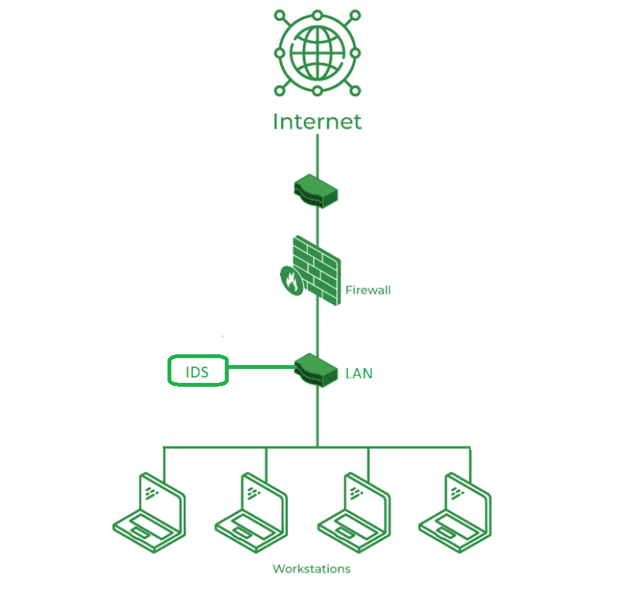

Slide 97
